Slide 2
Try This, Catch That, Finally
An Explanation on PowerCLI Error Handling

Slide 3
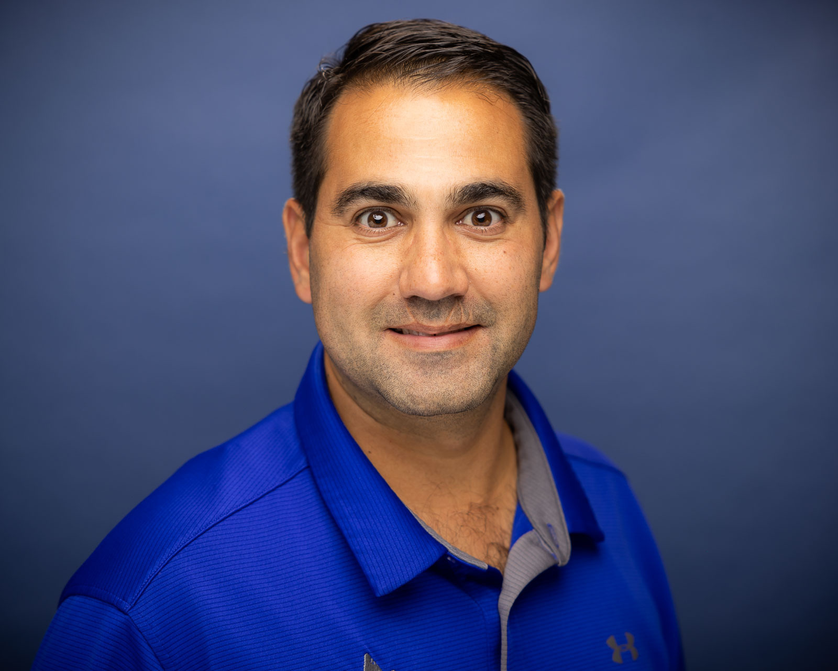
Justin Sider
Chief Information Officer, Belay Technologies

Slide 4

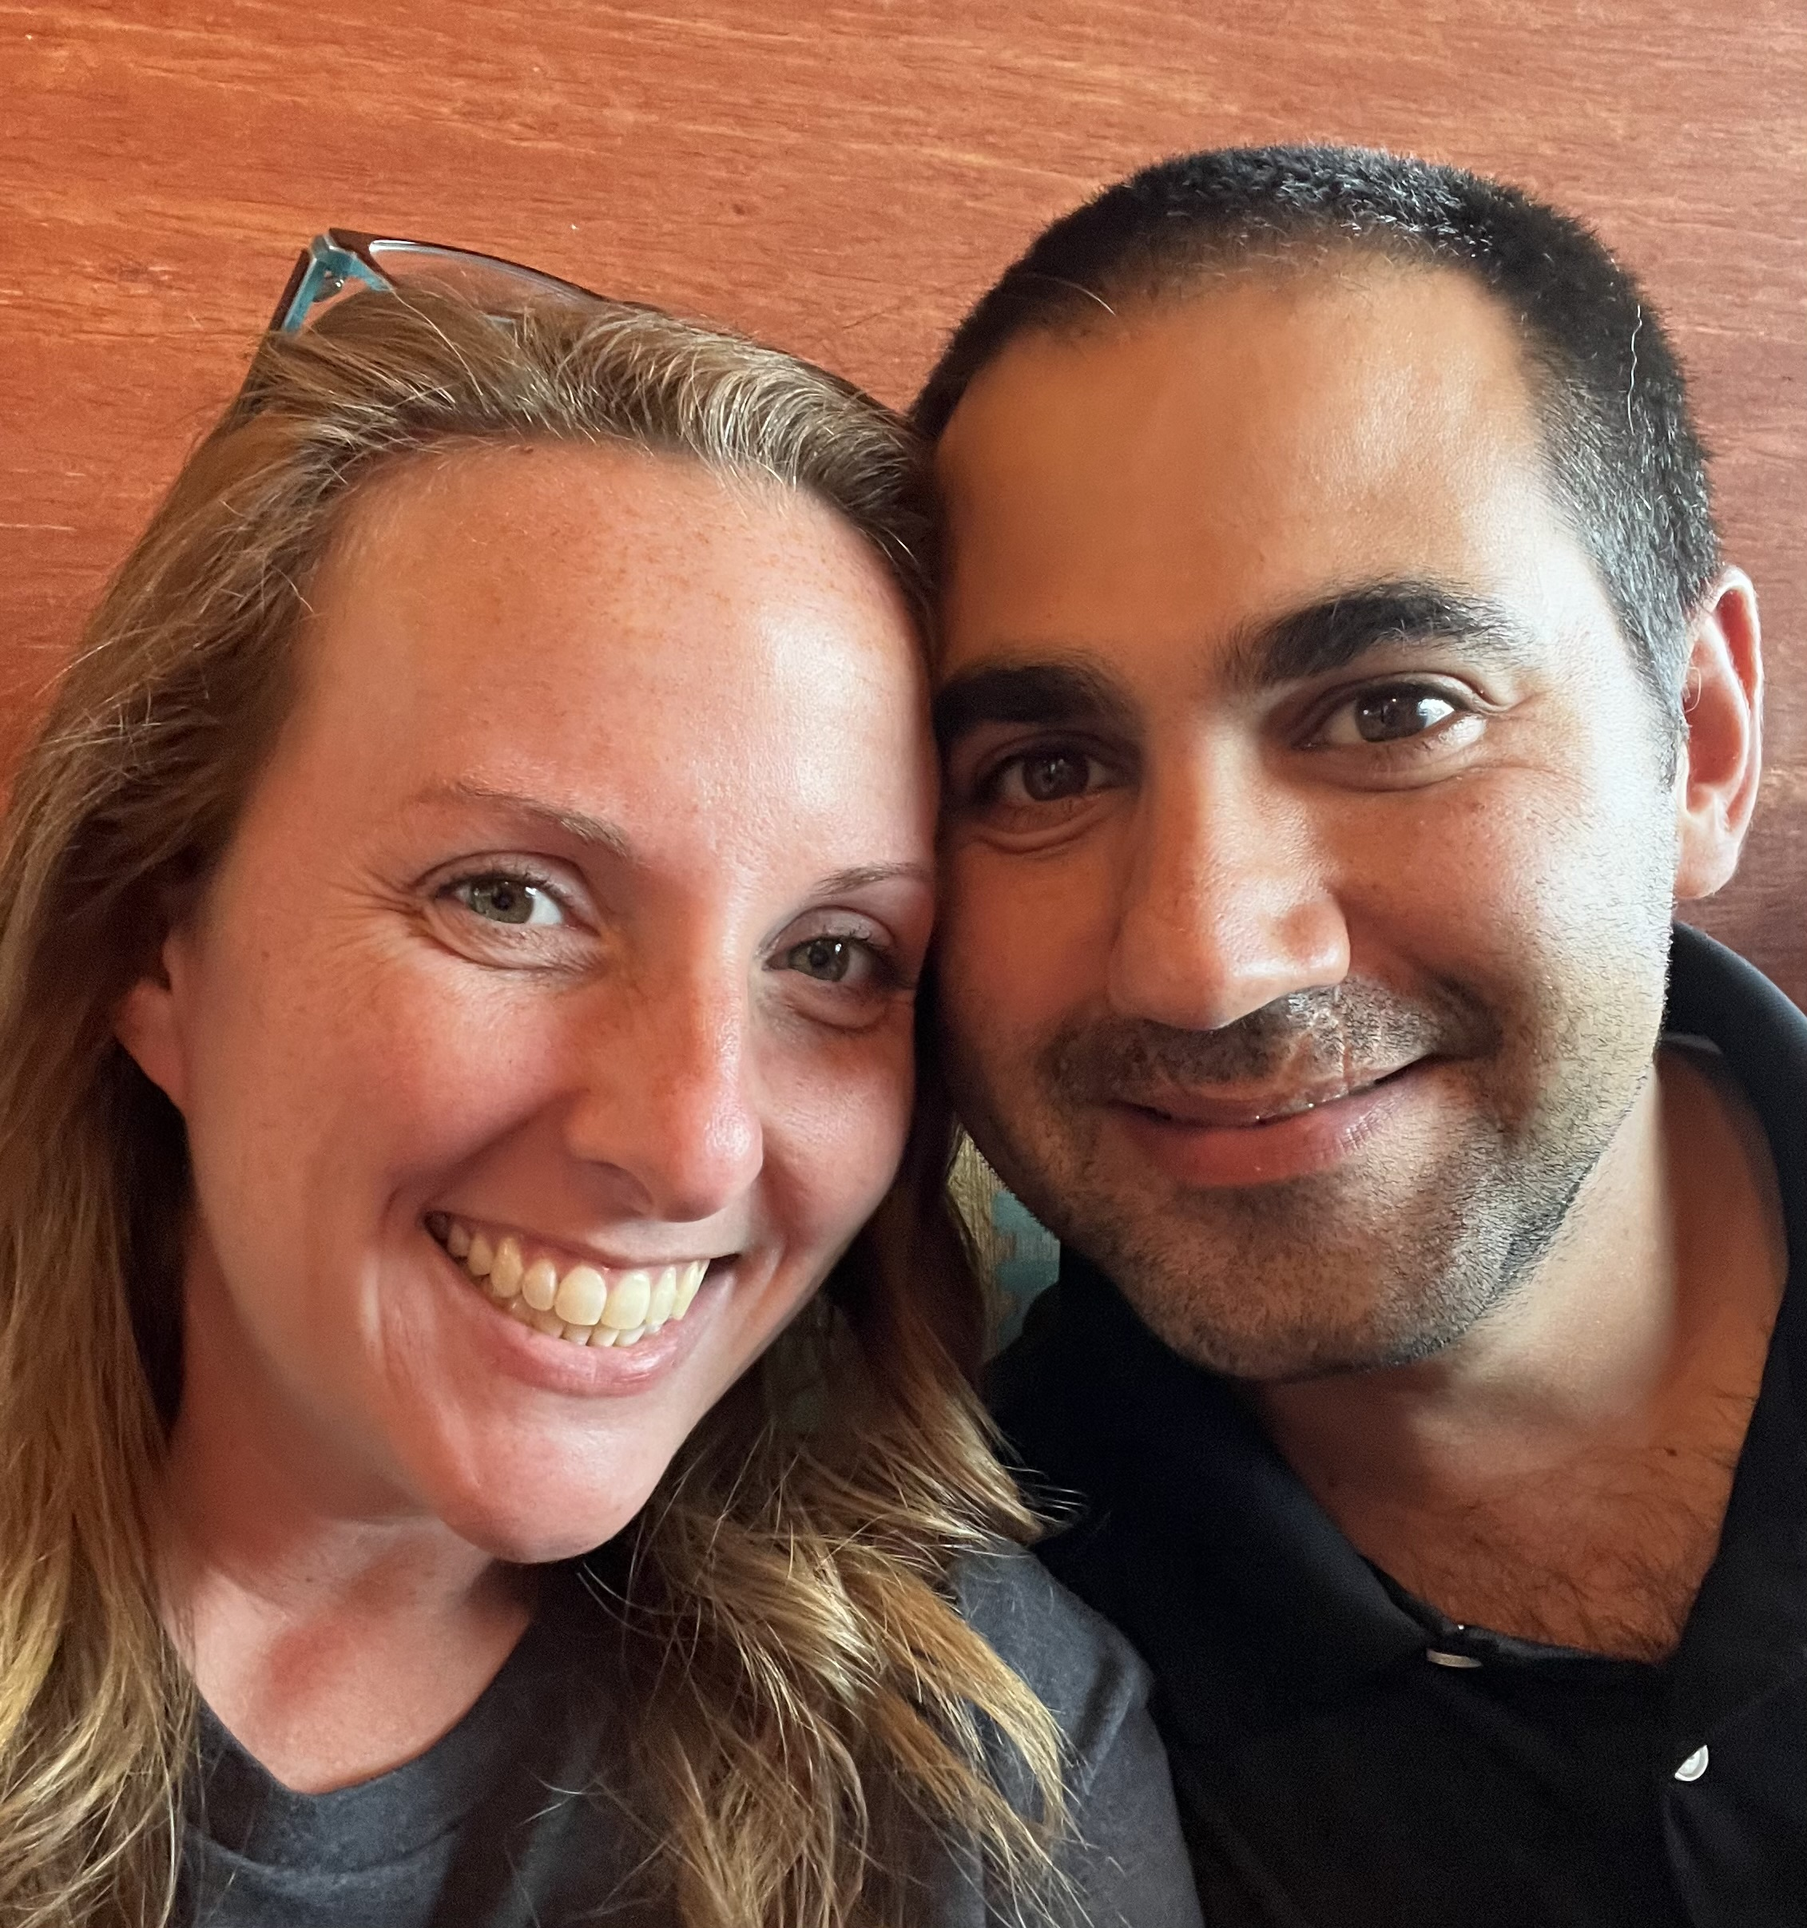
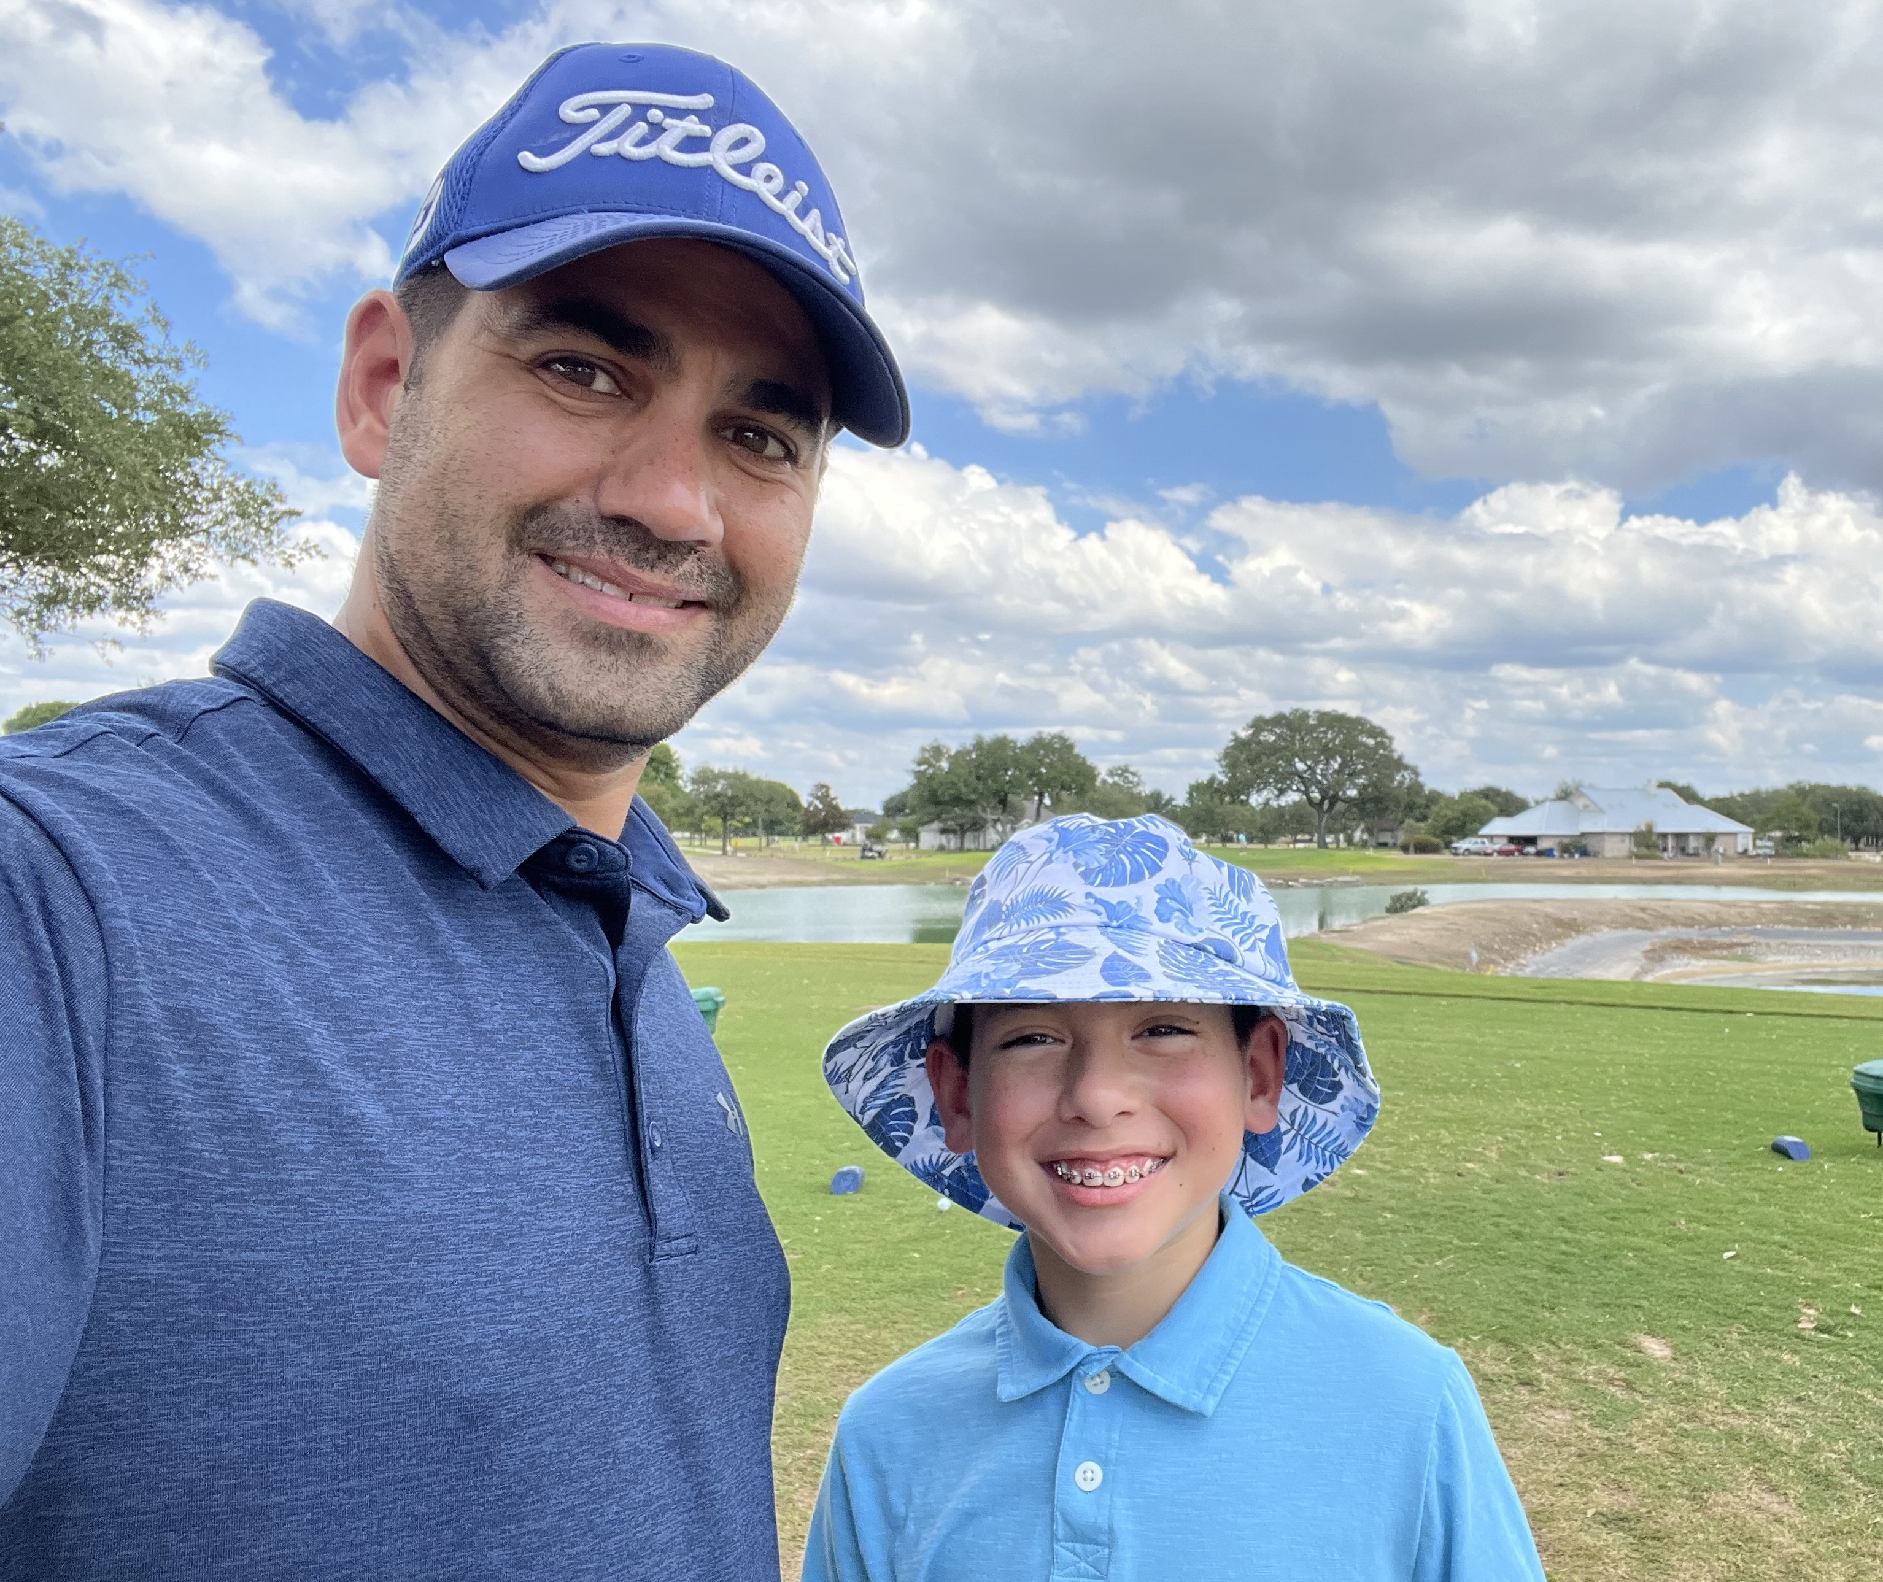
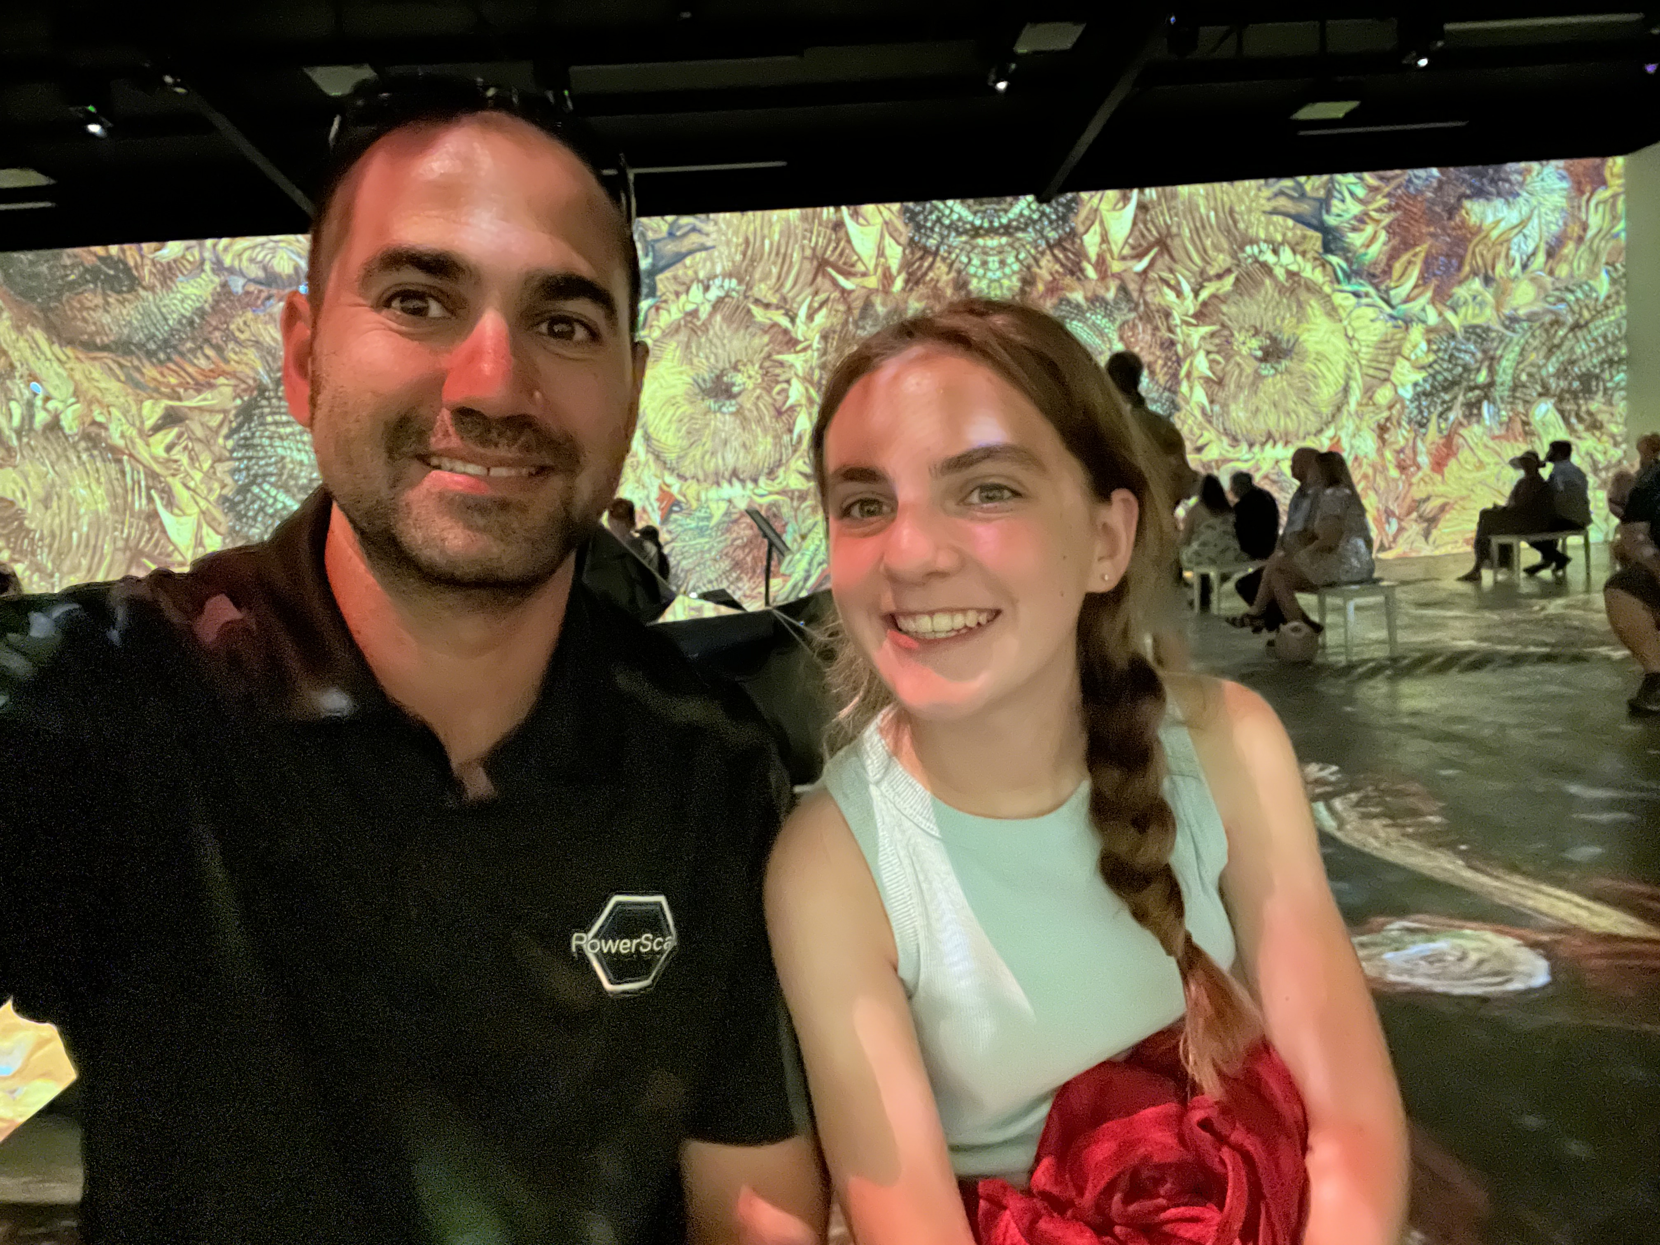
About Me
Blog
Invoke-automation.blog
Twitter(X)/Slack/GitHub
jpsider
VMware Programs
VMUG Advantage
VMUG Board of Directors
vExpert x10
VMware Code Coach 20-25

Slide 5
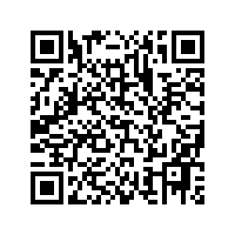
Agenda
Terminating Errors
Non-Terminating Errors
ErrorAction Thingys
Try & Catch
Finally
PowerCLI Demo!
API Demo!
Questions?
Link to Code!

Slide 14
You can do this!

Slide 17









ELEMENTS

